Slide 1
Software Testing
Fault Errors and Failures. RIPR Model

Slide 2
Fault, Error and Failure
Software Fault: A static defect in the software.
Software Error: An incorrect internal state that is the manifestation of some fault.
Software Failure: External, incorrect behavior with respect to the requirements or another description of the expected behavior.
Notes:
Fault and Error: A fault may remain undetected for a long time, until some event activates it. When an event activates a fault, it first brings the program into an intermediate error state.
Failure: If computation is allowed to proceed from an error state without any corrective action, the program eventually causes a failure.
As an aside, in fault-tolerant computing, corrective actions can be taken to take a program out of an error state into a desirable state such that subsequent computation does not eventually lead to a failure.

Slide 3
RIPR model
A test exposes a fault only if all four conditions hold:
Reachability – the test executes the faulty (defect) code.
Infection – executing that fault corrupts program state (a wrong value appears somewhere) (error).
Propagation – the corrupted state flows to an observable output/behaviour.
Revealability – the test’s oracle checks that output and can distinguish right from wrong.
Notes:
The RIPR model (Reachability, Infection, Propagation, and Revealability) is a foundational framework in software testing used to explain the conditions necessary for a software fault to result in an observable failure
First, a test must reach the location or locations in the program that contain the fault (Reachability).
After the location is executed, the state of the program must be incorrect (Infection).
Third, the infected state must propagate through the rest of the execution and cause some output or final state of the program to be incorrect (Propagation).
Finally, the tester must observe part of the incorrect portion of the final program state (Revealability).

Slide 4
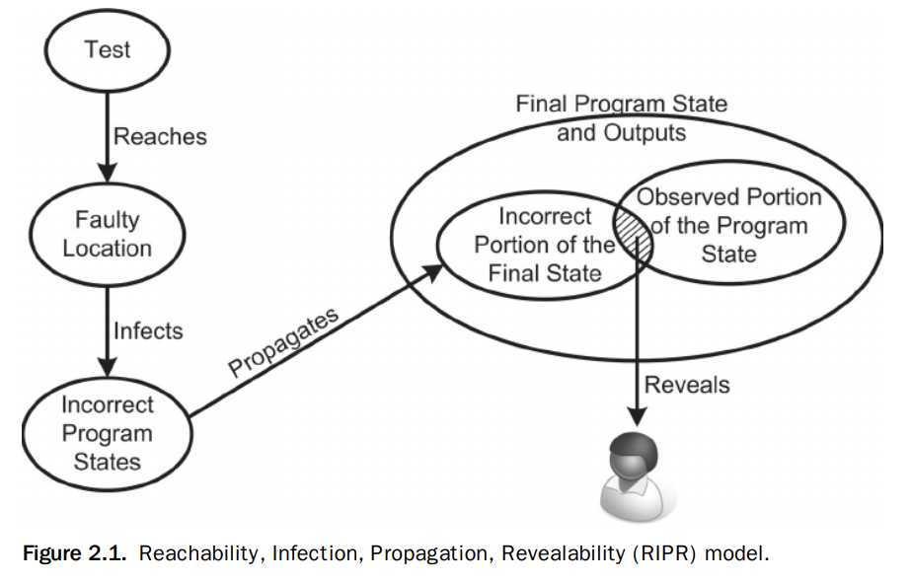
RIPR model

Slide 5
RIPR Simple Example
int max2(int a, int b) {
if (a > b) return a;
else return a; // BUG: should return b
}
Reachability: Use inputs that go to the else branch, e.g., a=2, b=5.
Infection: Because of the bug, result becomes 2 (wrong) → state infected.
Propagation: That wrong value is returned (visible at the interface).
Revealability: Your test asserts max2(2,5) == 5. If you don’t assert (or assert the wrong thing), the failure isn’t revealed.

Slide 6
Defect detection techniques
methods used in software development to find and identify errors, or "defects," in software before it is released.
The primary goal is to improve software quality, reduce the cost of fixing issues, and ensure the product meets its requirements.
These techniques are broadly categorized into static and dynamic methods.

Slide 7
Testing Categories
Static testing Dynamic testing
Testing without executing the program
🞄 Software inspection and some forms of analysis
Testing by executing the program with real inputs
Unit testing, integration testing, system testing, acceptance testing, …
🞄 Effective at finding certain kinds of problems such as problems that can lead to faults when the program is modified
Inspection, walkthrough, code review, informal review,
…

Slide 8
Defect detection techniques
Static Techniques
Inspections: A formal process where a team of developers, designers, and testers systematically reviews the source code. This is a very thorough method for finding defects that might not be apparent during execution.
Walkthroughs: A less formal review where the developer guides a team through the code, explaining its logic and design. The team provides feedback and identifies potential issues.
Static Analysis: Automated tools scan the source code for common errors, potential bugs, security vulnerabilities, and violations of coding standards. This is a highly efficient method for early defect detection.

Slide 9
Defect detection techniques
Dynamic Techniques
Unit Testing: The smallest components of the software (e.g., individual functions or methods) are tested in isolation to ensure they work correctly. This is usually done by the developers themselves.
Integration Testing: This type of testing checks how different software modules interact with each other, uncovering defects that arise when components are combined.
System Testing: The entire, integrated system is tested to verify that it meets the specified requirements. This includes functional, performance, and security testing.
Acceptance Testing: This is the final stage of testing where the software is validated against the user's requirements. It's often performed by end-users to ensure the product is ready for release.

Slide 10
Verification and Validation
Verification
Evaluation of software system that help in determining whether the product of a given development phase satisfy the requirements established before the start of that phase
Building the product correctly
Validation
Evaluation of software system that help in determining whether the product meets its intended use
Building the correct product

Slide 11
Validation and Verification (IEEE)
Validation
Evaluate software at the end of software development
Ensure compliance with the intended usage
Done by experts in the intended usage of the software, not developers
Verification
Evaluate software at a given phase of the development process
Fulfill the requirements established during the previous phase
Requires technical background on the software
Done by developers at the various stages of development
Notes:
Verification (The Technical Check)
Question: Does the code satisfy the written technical specifications?
The Test: You check if the input fields accept only numerical values. You verify that if a user enters a "Min" of $500,000 and a "Max" of $400,000, the system displays an error message ("Max must be greater than Min"). You check the database query to ensure it uses a BETWEEN clause correctly.
Validation (The User Experience Check)
Question: Does this feature actually help the user find a house effectively?
The Test: You give the app to actual home-buyers. They find that typing in exact numbers (like $455,500) on a mobile keyboard is tedious and slow. They would much rather have a Range Slider or a dropdown with pre-set increments (e.g., $100k, $200k).

Slide 12
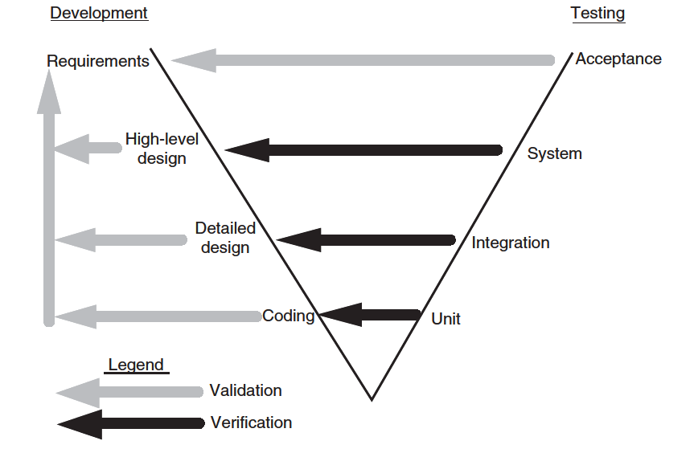
Development and Testing in V-model

Slide 13
Goals based on
Test Process Maturity
Beizer’s scale for test process maturity
Level 0: There is no difference between testing and debugging
Level 1: The purpose of testing is to show correctness
Level 2: The purpose of testing is to show that the software does not work
Level 3: The purpose of testing is not to prove anything specific, but to reduce the risk of using the software
Level 4: Testing is a mental discipline that helps all IT professionals develop higher quality software

Slide 14
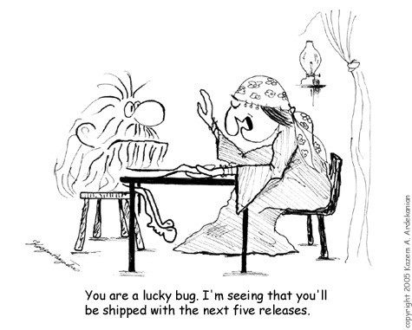
Level 0 – Testing is Debugging
Level 0: Testing is the same as debugging
Adopted by most CS students ☹
Get programs to compile
Debug with few arbitrarily chosen inputs or those provided by instructors
This approach is often ad hoc and unplanned, and testing is performed only by the developer.
It's a reactive, unsystematic process.
Notes:
This approach is often ad hoc and unplanned, and testing is performed only by the developer.
It's a reactive, unsystematic process.

Slide 15
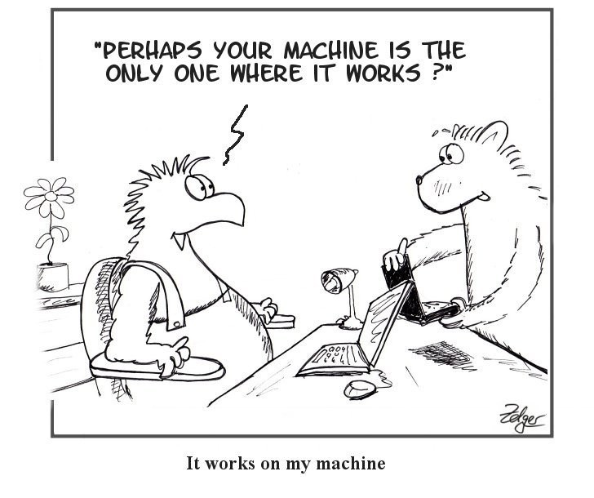
Levels 1 – Software Works
Level 1: To show correctness (developer-biased view)
Organizations at this level focus on "happy path" testing, where test cases are designed to show that the software meets its specified requirements.
The mindset is to prove correctness, not to find defects.
No strict goal, no stopping rule or formal test technique
No quantitatively way to evaluate; test managers are powerless
This can create a false sense of security and often misses edge cases and potential failures.
11
Notes:
Organizations at this level focus on "happy path" testing, where test cases are designed to show that the software meets its specified requirements.
The mindset is to prove correctness, not to find defects.
This can create a false sense of security and often misses edge cases and potential failures.

Slide 16
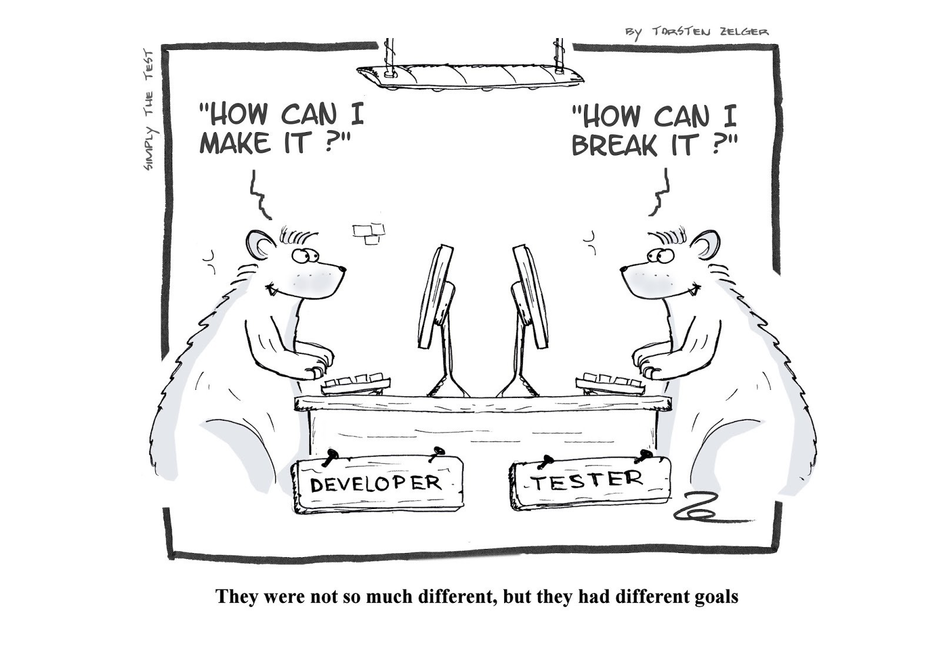
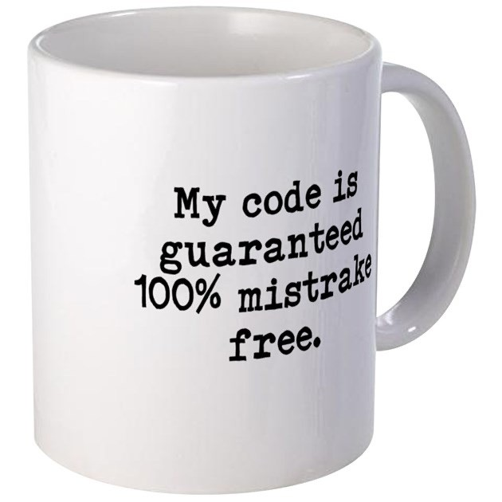

Levels 2 – Software Doesn’t Work
Level 2: To show failure (tester-biased view)
A negative view puts testers and developers into an adversarial relationship – bad team morale
What do we know if “no failures”?
Notes:
This level is a progression from Level 1, as the focus shifts to finding defects.
Testers and developers often have an adversarial relationship, as the tester's job is to "break" the software.
The primary goal is to find as many bugs as possible, with success measured by the number of faults found.

Slide 17
“Mature” Testing
Correctness cannot generally be achieved or demonstrated through testing.
Testing can only show the presence of failure, not the absence.
Developers and testers should be on the same boat.
How can we move to a team approach?

Slide 18
Levels 3 – Risk Reduction
Level 3: To reduce the risk of using the software
There are risks when using software
Some may be small with unimportant consequences
Some may be big with important consequences, or even catastrophic
Testers and developers cooperate to reduce risk
Notes:
The focus is on prioritizing tests based on the potential impact of a failure.
Testers and developers work together to identify high-risk areas and design tests to ensure the software is reliable, safe, and secure.

Slide 19
Levels 4 – Quality Improvement
Level 4: To increase quality of the software
Testing should be an integral part of the development process
Testers become technical leaders → measuring and improving software quality
Help developers improve the ability to produce quality software
Train developers
Testers and developers cooperate to improve the quality
Example: A team practices Test-Driven Development (TDD). Before writing a single line of feature code, the developer writes a test case. This forces them to think about edge cases and clear interfaces early. Because the code is "designed for testability," the final product is naturally higher quality and has fewer bugs from the start.

Slide 20
How “Mature” is Your Testing?
Are you at level 0, 1, 2, 3, or 4?
We hope to train you to become “change agents” (level 4)

Slide 21
Principles of Software Testing
Why testing is so hard
Exhaustive testing is impossible
We need to know when to stop testing
There is no silver bullet in software testing
Faults happen in some places more than others
Bug-free software does not exist
Testing is context-dependent
Verification is not validation
Notes:
3. there is no single tool, technology, or process that will, by itself, provide a massive jump in software quality or productivity.

Slide 22
Tactical Goals: Each Test
”If you don’t know why you’re conducting each test, it won’t be very helpful” – Jeff Offutt
What is objective and requirement of each test?
What fact does each test try to verify?
What are the threshold reliability requirements?
What are the planned coverage levels?
How many tests are needed?

